Slide 1
Tell Me More Than Just Assembly! Reversing Cyber-physical Execution Semantics of Embedded IoT Controller Software Binaries
Pengfei Sun†, Luis Garcia∗ and Saman Zonouz† †Rutgers University, ∗University of California, Los Angeles
06/26/2019
The 49th IEEE/IFIP International Conference on Dependable Systems and Networks

Slide 2
We live in a cyber-physical world…
* https://bricz.com/oms-integration/internet-of-thingsiot-and-cloud-computing-concept-smart-city-cyber-physical-systemscps/

Slide 3
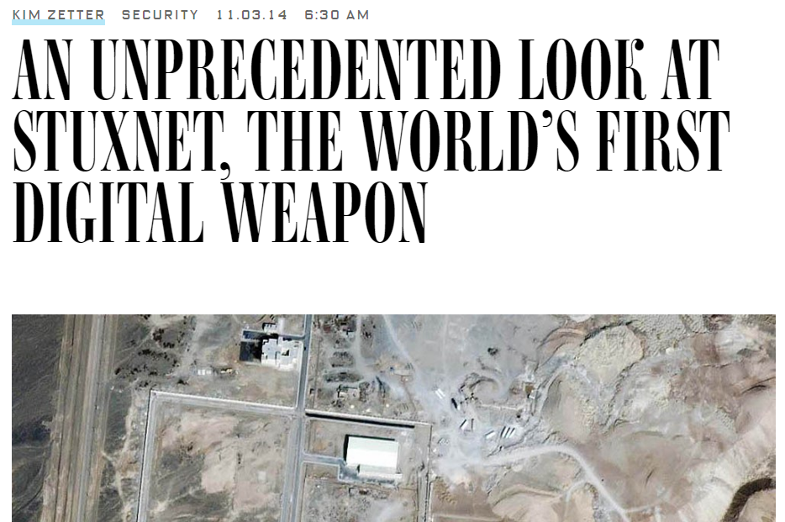
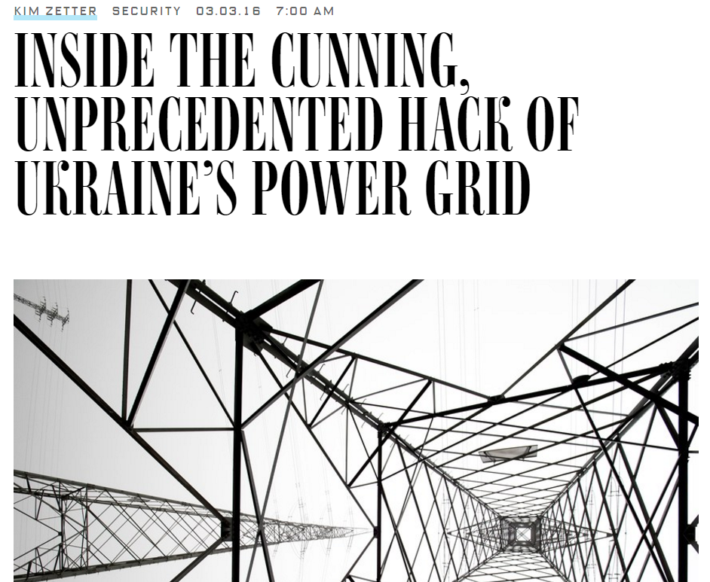

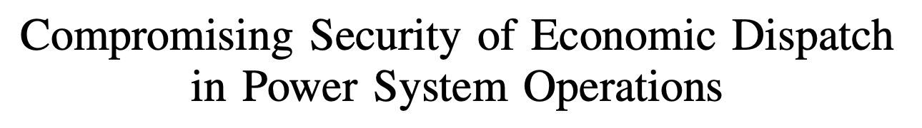
…and attacks are increasingly cyber-physical
Analyze and reverse engineer the system from security perspective

Slide 4

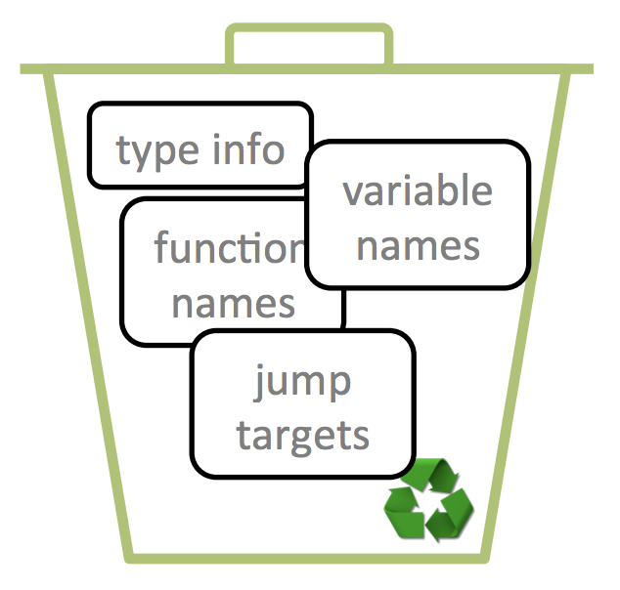
int gcd(int a, int b){
int com_divisor;
if(b!=0){
com_divisor = gcd (b, a % b);
}
else{
com_divisor = a;
}
return com_divisor;
}
Compile and Link
Strip

Slide 5
Reverse Engineering
8048094: push ebp
8048095: mov ebp, esp
8048097: sub esp, 0x18
804809a: cmp [ebp + 0xc]:32, 0x0
804809e: jnz 0x80480a5
80480a0: mov eax, [ebp + 0x8]:32
80480a3: jmp 0x80480c1
80480a5: mov eax, [ebp + 0x8]:32
80480a8: mov edx, eax
80480aa: sar edx, 0x1f
80480ad: idiv [ebp + 0xc]:32
80480b0: mov eax, edx
80480b2: mov [esp + 0x4]:32, eax
80480b6: mov eax, [ebp + 0xc]:32
80480b9: mov [esp]:32, eax
80480bc: call 0x8048094
80480c1: leave
80480c2: ret
Assembly code
Semantic information
Domain knowledge
Reverse Engineering
int32_t sub_8048094 (int32_t arg1, int32_t arg2){
int32_t eax1;
if(arg2!=0){
eax1=sub_8048094(arg2, arg1 % arg2);
}
else{
eax1=arg1;
}
return eax1;
}
???
Decompiler

Slide 6
didWeLose
gauntLetFound
infinityStoneCount
int32_t sub_8048094 (int32_t arg1, int32_t arg2){
int32_t eax1;
if(arg2!=0){
eax1=sub_8048094(arg2, arg1 % arg2);
}
else{
eax1=arg1;
}
return eax1;
}
Decompiler

Slide 7
Mismo: Domain-specific Reverse Engineering Framework
Propose a domain-specific reverse engineering framework to extract high-level algorithmic control- and data-flow semantics from embedded binary executables.
Introduce a semantic mapping using dynamic binary analysis and symbolic comparison of the mathematical and binary expressions to fill the semantic gap between high-level algorithm descriptions and low-level stripped binary segments.

Slide 8

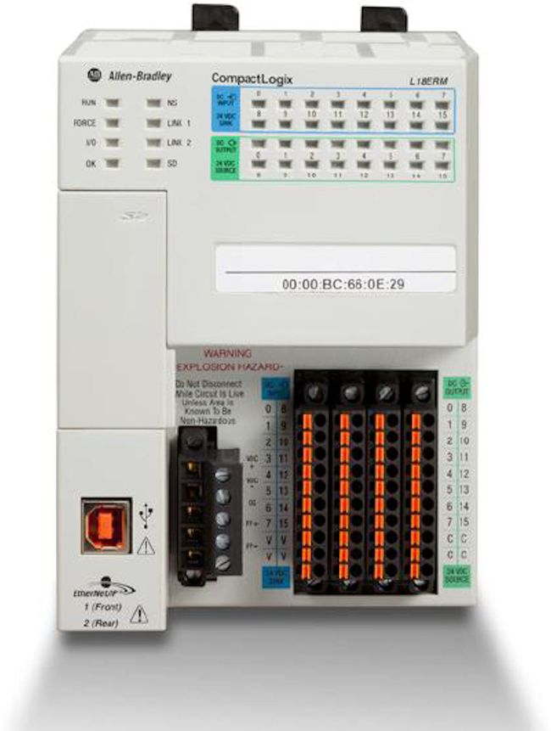
Domain Knowledge (Cyber-physical System)
Proportional-Integral-Derivate (PID)
Pulse-width modulation (PWM)
Input
(sensor data)
Control Algorithm
Output
(actuation)
Kalman-Filters

Slide 9
Current Solutions
IDA PRO
OllyDbg
Ninja
Snowman
(Commercial or open source tools)
Disassembler,
Decompiler,
Static and dynamic analysis
Reward (NDSS’10)
TIE (NDSS’11)
Howard (NDSS’11)
ReViver (ACSAC’16)
Data structure definition,
Data structure memory instance
BinDiff (SSTIC'05)
BinJuice (PPREW '13)
Blex (Usenix’14)
Binary similarity checking

Slide 10
Mismo Overview
Control Algorithm’s Subroutine Identification
Binary executable
ICS/IoT Device
Controller Code
(binary executable)
Symbolic Controller
Abstract Syntax Trees
CFG Refinement
ICS/IoT
Control Algorithms
Algorithm
Algorithmic Mathematical
Abstract Syntax Trees

Slide 11

Mismo Overview
Symbolic Controller
Abstract Syntax Trees
Formal Symbolic
Equivalence Check
Annotated
Disassembly
Algorithmic Mathematical
Abstract Syntax Trees

Slide 12
Mismo Overview
Control Algorithm’s Subroutine Identification
ICS/IoT Device
Controller Code
(binary executable)
Symbolic Controller
Abstract Syntax Trees
CFG Refinement
ICS/IoT
Control Algorithms
Algorithmic Mathematical
Abstract Syntax Trees
Formal Symbolic
Equivalence Check

Slide 13
Case Study
Control Algorithm’s Subroutine Identification
Taint analysis
Arithmetic operations
ICS/IoT Device
Controller Code
(binary executable)
Symbolic Controller
Abstract Syntax Trees
CFG Refinement
ICS/IoT
Control Algorithms
Algorithmic Mathematical
Abstract Syntax Trees
Formal Symbolic
Equivalence Check

Slide 14
Case Study
Control Algorithm’s Subroutine Identification
ICS/IoT Device
Controller Code
(binary executable)
Symbolic Controller
Abstract Syntax Trees
CFG Refinement
Errors checking,
Value range checking
ICS/IoT
Control Algorithms
Algorithmic Mathematical
Abstract Syntax Trees
Formal Symbolic
Equivalence Check
14

Slide 15
Case Study
Control Algorithm’s Subroutine Identification
ICS/IoT Device
Controller Code
(binary executable)
Symbolic Controller
Abstract Syntax Trees
CFG Refinement
ICS/IoT
Control Algorithms
Algorithmic Mathematical
Abstract Syntax Trees
Formal Symbolic
Equivalence Check

Slide 16
Case Study
Symbolic expression
…
0x90DE: VMUL.F64 D6, D6, D7
-> 0xc0175999f54482ee
0x90E2: VLDR D7, [R7,#0x3C+var_2C]
-> 0x4028000000000000
0x90E6: VADD.F64 D7, D6, D7
-> 0x4018a6660abb7d12
…
Symbolic
output
variable
Backward value analysis
Symbolic execution
Symbolic Controller
Abstract Syntax Trees
Symbolic
input
variables
Backward slicing analysis

Slide 17
Case Study
Symbolic expression
(for Kalman filter – obtained by symbolic execution of the controller binary file)
((((Sym_15 ∗ (((Sym_12 ∗ Sym_11) ∗ Sym_13) + Sym_14)) / ((Sym_19 ∗ (Sym_15 ∗ (((Sym_12 ∗ Sym_11) ∗ Sym_13) + Sym_14))) + Sym_16)) ∗ ((((Sym_7) ^ (-1) ∗ Sym_8) + ((Sym_5 ∗ (((Sym_3) ^ (-1) ∗ Sym_4) + ((Sym_0 ∗ Sym_1) + (Sym_18 ∗ Sym_2)))) + (Sym_18 ∗ Sym_6))) − ((Sym_19 ∗ ((Sym_18 ∗ Sym_10) + (Sym_11∗ Sym_9))) + (Sym_17 ∗ Sym_18)))) + ((Sym_18 ∗ Sym_10) + (Sym_11 ∗ Sym_9)))
Symbolic Controller
Abstract Syntax Trees

Slide 18
Case Study
Symbolic Controller
Abstract Syntax Trees
(obtained from the controller binary files)

Slide 19
Case Study
Algorithmic Mathematical
Abstract Syntax Trees
(obtained from the control algorithm)

Slide 20
Mismo Overview
Sym_3 -> Q
Sym_7 -> R
…
Formal Symbolic
Equivalence Check

Slide 21
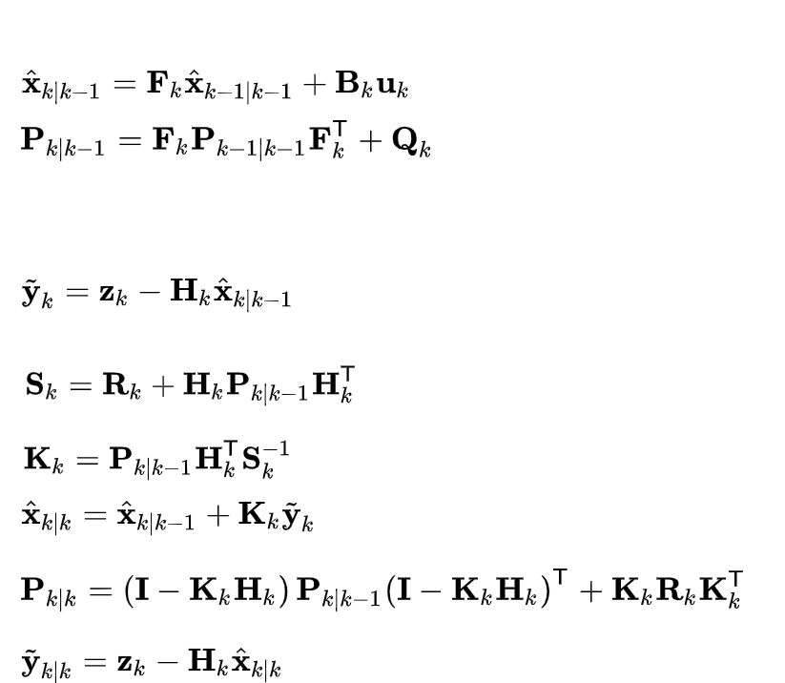
Annotated Disassembly

Slide 22
Evaluation
Data: the portion of resolved symbolic variables
Accuracy
Code: the portion of resolved instructions

Slide 23
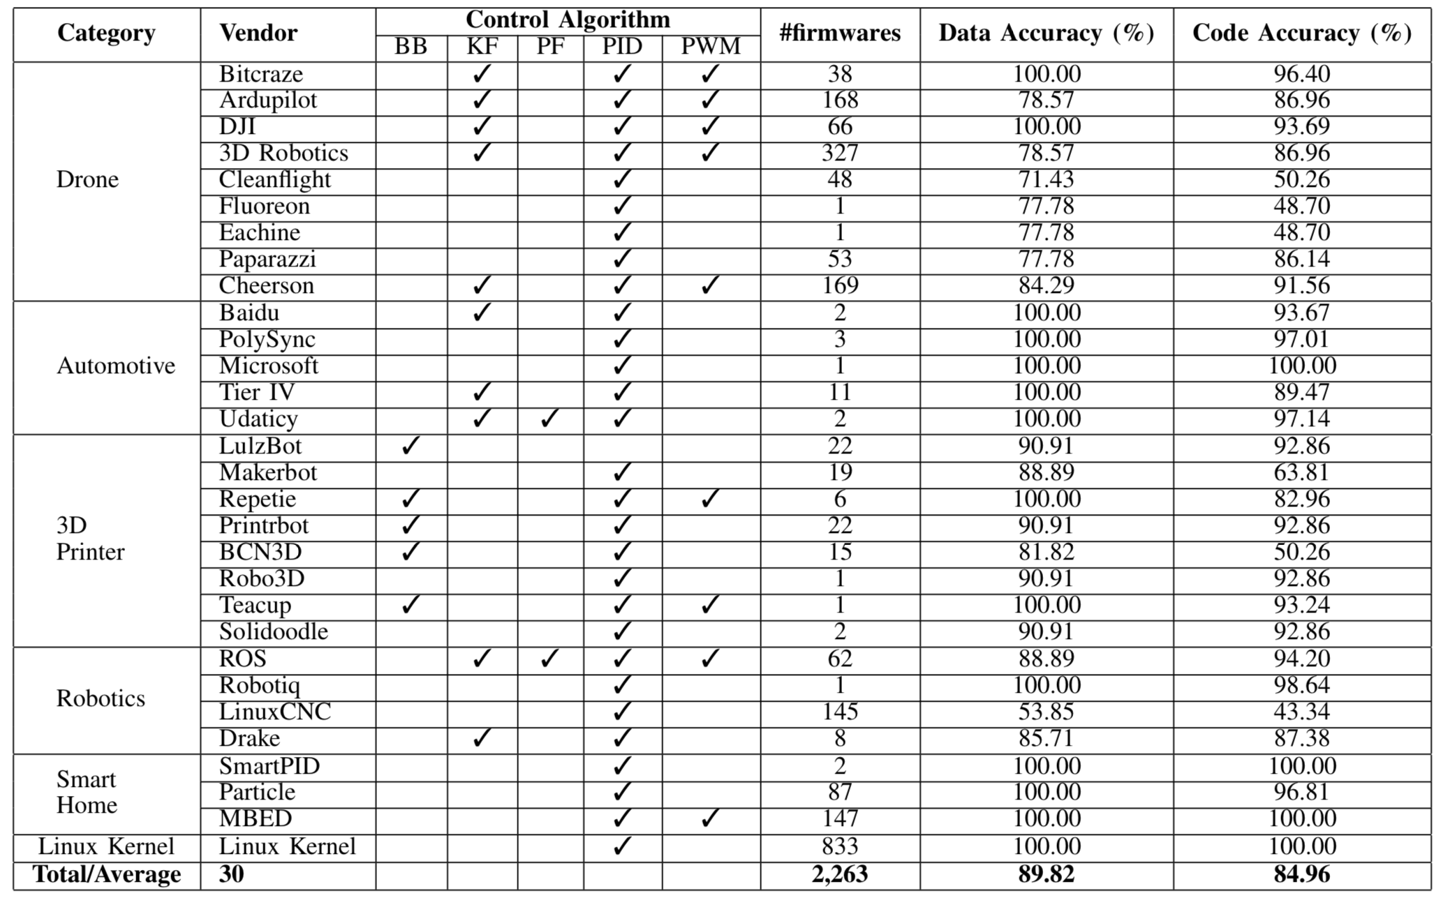
Evaluation

Slide 24
Potential Use-cases

Slide 25
Potential Use-cases
Binary vulnerability assessment

Slide 26
Potential Use-cases
Binary vulnerability assessment
Memory forensics analysis

Slide 27
Potential Use-cases
Binary vulnerability assessment
Memory forensics analysis
Sensitive code and data segment protection

Slide 28
Potential Use-cases
Binary vulnerability assessment
Memory forensics analysis
Sensitive code and data segment protection
Correct algorithm implementation verification

Slide 29
Potential Use-cases
Binary vulnerability assessment
Memory forensics analysis
Sensitive code and data segment protection
Correct algorithm implementation verification
Binary-level software similarity measures

Slide 30
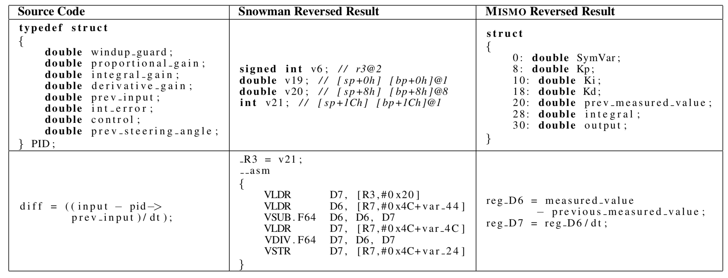
Comparison with Snowman (decompiler)

Slide 31
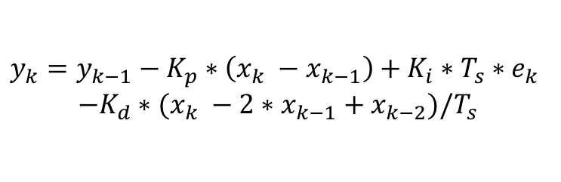
We Discovered/reported a Linux Kernel Bug
$$y_{k}={y_{k−1}−K_{p}∗\left(x_{k} −x_{k−1}\right)+K_{i}∗T_{s}∗e}_{k}$$
$$−K_{d}∗(x_{k} −2∗x_{k−1}+x_{k−2})/T_{s}$$
Algorithm
Mismo
Program Code
…
/* compute intermediate PID terms */
p_term = -p_param.kp * (xk - xk_1);
i_term = p_param.kp * p_param.ki * p_param.ts * ek;
d_term = -p_param.kp * p_param.kd * (xk - 2 * xk_1
+xk_2) / p_param.ts;
/* compute output */
*yk += p_term + i_term + d_term;
…

Slide 32
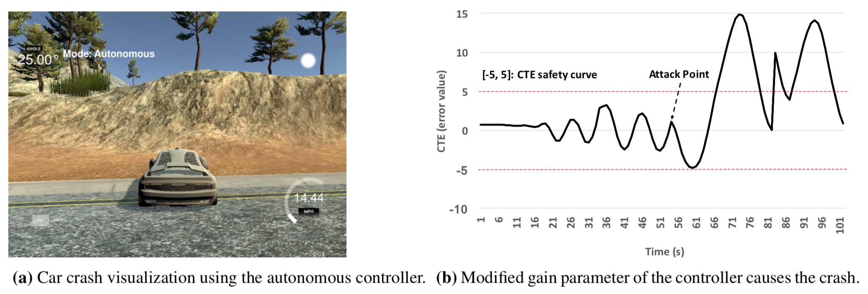
Attack Control Algorithm Parameter

Slide 33
Conclusions & QA
A general framework to extract semantic information of an embedded firmware binaries with respect to its associated high-level control algorithm.
Using dynamic binary analysis and symbolic comparison of the mathematical and binary expressions to fill the semantic gap between high-level algorithm descriptions and low-level stripped binary segments.
Thank You
Questions?
Email: pengfei.sun@rutgers.edu

